Slide 1




PHP Flow Control
Conditional Statements, Loops, Functions, Include and Require
Svetlin Nakov
Technical Trainer
www.nakov.com
Software University
http://softuni.bg

Slide 2


Table of Contents
Conditional Statements
Loops
Functions and Return Value
Include and Require
Variable Scope

Slide 3

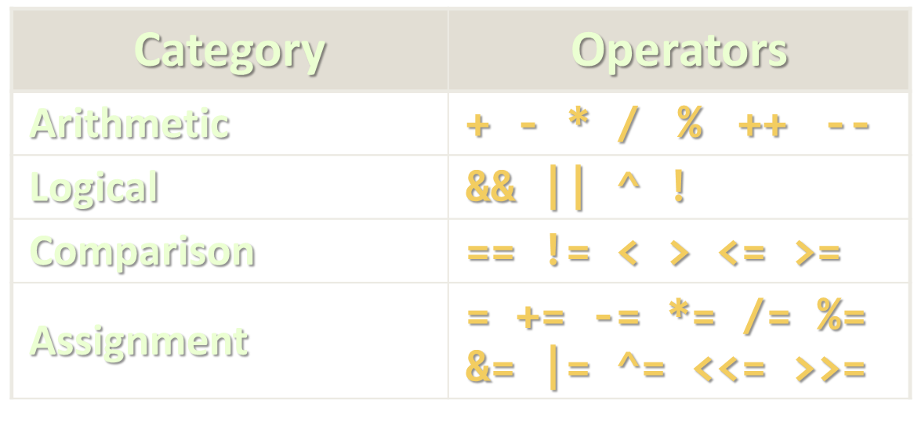
Comparison and Logical Operators

Slide 4
PHP Comparison Operators
Operator | Notation in PHP | Example
Equal | == | $x == $y
Identical | === | $x === $y
Not equal | !=, <> | $x != $y, $x <> $y
Not identical | !== | $x !== $y
Greater than | > | $x > $y
Less than | < | $x < $y
Greater than or equal to | >= | $x >= $y
Less than or equal to | <= | $x <= $y

Slide 5
PHP Logical Operators
Operator | Notation in C# | Example
And | and, && | $x and $y, $x && $y
Or | or, || | $x or $y, $x || $y
Xor | xor | true || false → true
Not | ! | !$x

Slide 6

Conditional Statements

Slide 7
If Statements
The condition is evaluated
If it is true, the statement is executed
If it is false, the statement is
Condition
<?php
if ($a > $b){
echo "a is bigger than b";
}
?>
The code block is executed if the expression is true

Slide 8
If-Else
if-else construct is extension of if construct and allows you to execute one code if condition is met or another if not
<?php
if ($a > $b) {
echo "a is greater than b";
} else {
echo "a is NOT greater than b";
}
?>

Slide 9
Else-if
Else-if is a combination of if and else
Performs a sequence of checks
<?php
if ($a > $b) {
echo "a is bigger than b";
} else if ($a == $b) {
echo "a is equal to b";
} else {
echo "a is smaller than b";
}
?>

Slide 10
Alternative If
PHP offers an alternative syntax for the if-statement:
<?php
$a == 5;
if ($a == 5):
echo "a equals 5";
echo "...";
elseif ($a == 6):
echo "a equals 6";
echo "!!!";
else:
echo "a is neither 5 nor 6";
endif;
?>

Slide 11
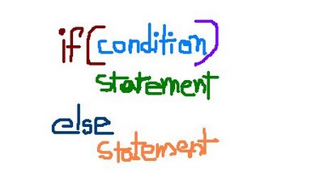
Else-if
Live Demo

Slide 12
Switch
The switch-case statement
Similar to a series of if statements on the same expression
switch ($i) { case 0:
echo "i equals 0";
break; case 1:
echo "i equals 1";
break; case 2: echo "i equals 2";
break; }
if ($i == 0) {
echo "i equals 0";
} elseif ($i == 1) {
echo "i equals 1";
} elseif ($i == 2) {
echo "i equals 2";
}
Equal

Slide 13
Switch (2)
Similar to else, you can have default case in a switch
If no case option is found, the default option is executed
The default case is not obligatory the last one
switch ($str) {
case "p": echo "Hello Pesho"; break;
case "g": echo "Hello Gosho"; break;
default:
echo "Who are you"; break;
}

Slide 14
Switch (3)
When the engine moves to the found case it does NOT exit after the code of that case but moves on to the next one
This example will output "Hello Pesho Hello Gosho "
The solution is to add break where necessary
This applies to the default case too
$str = "p";
switch ($str) {
case "p": echo "Hello Pesho";
case "g": echo "Hello Gosho";
}

Slide 15
Switch (4)
Multiple cases could be combined by using empty cases
In case of 1 , 2 or 4, this code will print "A is 1 or 2 or 4"
$a = 0;
switch ($a) {
case 0: echo "A is 0"; break;
case 1:
case 4:
case 2: echo "A is 1 or 2 or 4"; break;
}

Slide 16
Switch (5)
You can use any scalar type of variable (string, number, boolean, etc.)
switch ($name) {
case "Dimitar": echo 1; break;
case "Svetlin":
case "Nakov": echo 2; break;
case false: echo "No name"; break;
default: echo "?!"; break;
}

Slide 17
Alternative Switch Syntax
PHP offers an alternative syntax for switch constructs:
$variable = 2;
switch($variable):
case 1:
echo "<div>News</div>";
break;
case 2:
echo "<div>Forum</div>";
break;
endswitch;

Slide 18
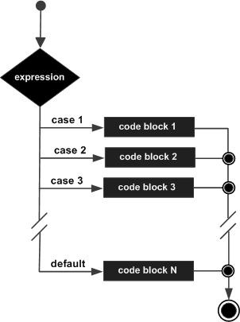
Switch
Live Demo

Slide 19
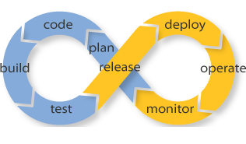
Loops

Slide 20
While Loop
While loops are the simplest type of loop in PHP
Repeat a block of code while a certain condition holds:
The body consists of one or more statements
If more than one, surrounding brackets are required
The condition expression is of type boolean
while (expr) {
statement;
}
while (expr):
statement
endwhile;

Slide 21
While Loop – Example
Printing the numbers from 1 to 10:
<?php
$counter = 1;
while ($counter <= 10) {
echo "<p>$counter</p>";
$counter++;
}
?>

Slide 22
Do { … } while()
Do-while loops repeat a code block until some condition breaks
Similar to while-loops
The loop expression is checked at the end of each iteration
Loop body runs at least once
<?php
$i = 10;
do {
echo $i; // print 10, 9, 8, …, 0
i--;
} while ($i > 0);
?>

Slide 23
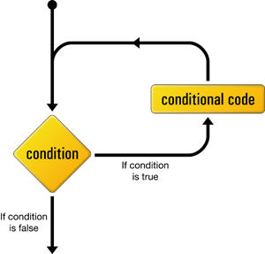
While Loops
Live Demo

Slide 24

For Loops
The classical for-loop syntax is:
Consists of
Initialization statement
Boolean test expression
Update statement
Loop body block
for (initialization; test; update) { statements; }

Slide 25
For Loop – Examples
A simple for-loop to print the numbers 0…9:
for ($number = 0; $number < 10; $number++) {
echo $number . " ";
}
A simple for-loop to calculate n!:
$n = 5; $factorial = 1;
for ($i = 1; $i <= $n; $i++) {
$factorial *= $i;
}

Slide 26
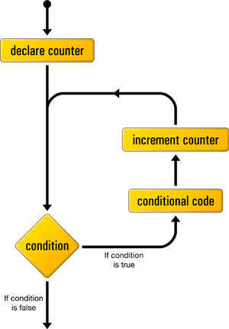
For-Loop
Live Demo

Slide 27
Foreach
The foreach construct iterates over arrays
Тwo syntaxes:
foreach (array_expression as $value) {
statements;
}
foreach (array_expression as $key => $value) {
statements;
}

Slide 28
Foreach – Examples
$colors = array("red", "green", "blue", "yellow", "orange");
foreach ($colors as $value) {
echo "$value <br>";
}
$colorMap = array("red" => "#FF0000", "green" => "#00FF00",
"blue" => "#000FF");
foreach ($colorMap as $key => $value) {
echo "<p>$key -> $value</p>";
}

Slide 29

Foreach
Live Demo

Slide 30
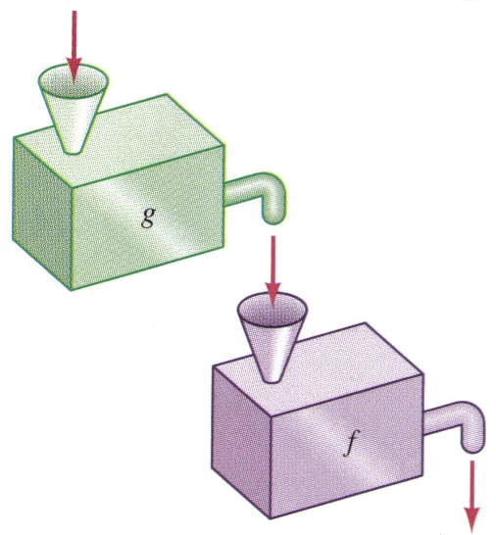
Functions and Return Value

Slide 31
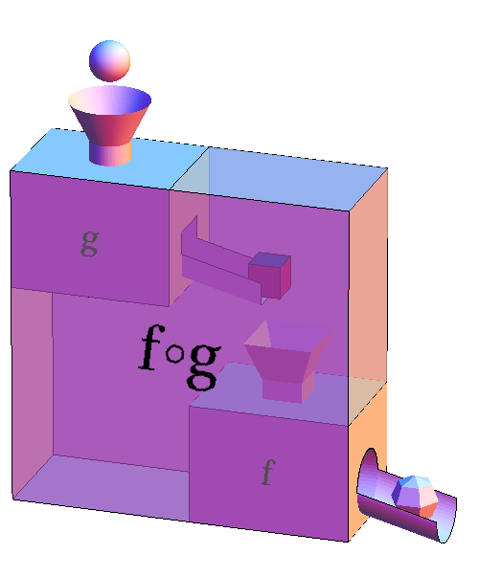
Functions
Functions are named blocks of code
Declared with the keyword function
Can accept parameters and return value
Help organize and reuse the code
function rectangleArea($sideA, $sideB) {
return $sideA * $sideB;
}
echo rectangleArea($a, $b);

Slide 32
Function with Parameters – Example
function strIsEqual($str1, $str2, $ignoreCase = true) {
if ($ignoreCase)
return strtolower($str1) == strtolower($str2);
else
return $str1 == $str2;
}
echo strIsEqual("hello", "HeLLo", true); // 1 (true)
echo strIsEqual("hello", "HELLO"); // 1 (true)
echo strIsEqual("hello", "Hello", false); // "" (false)

Slide 33
Functions Parameters: Pass by Reference
By default PHP passes arguments to functions by value
Changing arguments in the function will be lost after its ends
To force pass by reference use the & prefix
function changeValue(&$arg) {
$arg += 100;
}
$num = 2;
echo $num; // 2
changeValue($num);
echo $num; // 102

Slide 34
Variable Number of Parameters
PHP supports variable-length function parameters
Read the parameters: func_num_args() and func_get_args()
function calcSum() {
$sum = 0;
foreach (func_get_args() as $arg) {
$sum += $arg;
}
return $sum;
}
echo calcSum(1, 2), '<br />'; // 3
echo calcSum(10, 20, 30), '<br />'; // 60
echo calcSum(10, 22, 0.5, 0.75, 12.50), '<br />'; // 45.75

Slide 35
Returning Values from a Function
Functions can return values with the return statement
Accepts only one argument – the value to be returned
Exits the function
To return multiple values you can use arrays
Function is not obligatory to return a value
function foo ($arg) {
return true;
// the following code will NOT be executed
echo $arg + 1;
}

Slide 36
Returning Multiple Values from a Function
You can use fixed-size arrays to return multiple values
The list keyword assigns multiple variables from array items
This is NOT a function like array
Works only for numerical arrays and assumes indexes start at 0
function small_numbers () {
return array (0, 1, 2); }
list($a, $b, $c) = small_numbers();
// The result will be: $a = 0; $b = 1; $c = 2;

Slide 37
Variable Functions
PHP supports variables holding a function
Can be invoked through the () operator
function func($arg) {
echo "This is function. Arg = $arg";
}
$a = 'func';
$a(5); // this invokes func(5) function

Slide 38
Few Notes on Functions
You can check if function is declared with function_exists($name)
Functions can be nested (declared inside other functions)
They do not exist until the outer function is called
if (!function_exists('func')) {
function func($arg) { … }
}
function func($arg) {
function second($arg) { … }
second('hello');
}

Slide 39

Include and Require
Including a Script from Another Script

Slide 40
Include and Require
include and require load and evaluate a file holding PHP code
Useful to structure and reuse the code
Both accept single parameter – a file name
Difference between include and require:
If file is not found include produces a warning
require produces a fatal error
include "header.php";
echo "page body comes here";
include "footer.php";

Slide 41
include_once and require_once
include_once and require_once are forms of include and require
With include and require you can include one file many times and each time it is evaluated
With include_once and require_once if file is already included, nothing happens
For instance if in the file you have declared a function, double including will produce error "Function with same name already exists"
Example:
require_once "functions.php";

Slide 42
Include
Live Demo

Slide 43

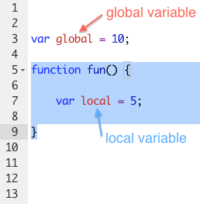
Variables Scope

Slide 44
Variables Scope
The arrays $_GET, $_POST, $_SERVER , $_REQUEST and other built-in variables are global
Can be accessed at any place in the code
Variables, declared in functions exist only until the end of function
Files being included/required inherit the variable scope of the caller
Variables declared outside of a function are not accessible in it
$name = $_GET['firstName'] . $_GET['lastName'];

Slide 45
The Global Keyword
Variables outside of a function are not accessible in it:
To access an external variable use the global keyword
$a = "test"; // global scope
function foo () {
echo $a; // this will not output anything (local scope)
}
foo();
$a = "test";
function foo () {
global $a; // the global variable $a in include in the scope
echo $a; // this will output "test"; }
foo();

Slide 46
Loops and Variable Scope
Variables, declared in loops are accessible after the loop ends
A variable in PHP is declared with its first assignment
for ($i = 0; $i < 5; $i++) {
$arr[] = $i;
}
print_r($arr); // outputs 0, 1, 2, 3, 4
$a = 15;
if ($a == 5) { $five = 'five'; }
else { $five = 'not five'; }
echo $five; // not five

Slide 47
Static Keyword
Static variables in PHP are initialized only once (on demand)
Their existing values are preserved in the next calls of the same function
function callMe() {
static $count = 0; // initialized at the first call
$count++; // executed at each function call
echo "callMe() is called $count times\n";
}
callMe(); // callMe() is called 1 times
callMe(); // callMe() is called 2 times

Slide 48
Note on Brackets
PHP is designed to mix HTML and PHP code:
This is similar to writing echo "Hello John!";
Very useful for long texts
<?php $name = "John"; ?>
<?php if ($name == "John") { ?>
<p>Hello John!</p>
<?php } else { ?>
<p>You are not John.</p>
<?php } ?>

Slide 49


Summary
Conditional Statements
If-Else
Switch-Case
Loops
Do-while, While, For, Foreach
Functions, Parameters and Return Value
Include and Require
Variable Scope
PHP & MySQL

Slide 50
PHP Flow Control
https://softuni.bg/trainings/fasttracks/details/1033

Slide 51
License
This course (slides, examples, demos, videos, homework, etc.) is licensed under the "Creative Commons Attribution-NonCommercial-ShareAlike 4.0 International" license
Attribution: this work may contain portions from
"PHP Manual" by The PHP Group under CC-BY license
"PHP and MySQL Web Development" course by Telerik Academy under CC-BY-NC-SA license

Slide 52





Free Trainings @ Software University
Software University Foundation – softuni.org
Software University – High-Quality Education, Profession and Job for Software Developers
softuni.bg
Software University @ Facebook
facebook.com/SoftwareUniversity
Software University @ YouTube
youtube.com/SoftwareUniversity
Software University Forums – forum.softuni.bg

